Slide 1
Tutorial: Introduction to Verilog

Slide 2
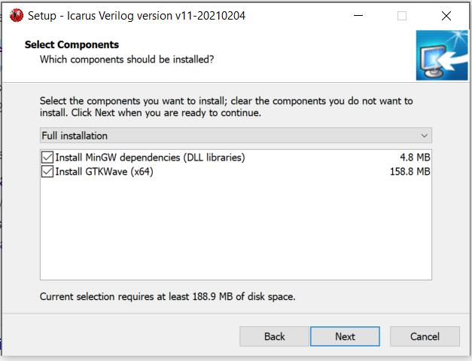
iVerilog & GTKWave (Windows)
Icarus Verilog for Windows:
http://bleyer.org/icarus/
GTKWave examples:
https://iverilog.fandom.com/wiki/GTKWave

Slide 3
iVerilog & GTKwave (Linux)
Install:
apt install iverilog gtkwave
compile and generate triangle.out
iverilog -o triangle.out testfixture.v triangle.v
execute and generate dump.vcd
vvp triangle.out
Display wave
gtkwave dump.vcd
iverilog is a compiler that translates Verilog source code into executable programs for simulation, or other netlist formats for further processing. The currently supported targets are vvp for simulation, and fpga for synthesis.
vvp is the run time engine that executes the default compiled form generated by Icarus Verilog. The output from the iverilog command is not by itself executable on any platform. Instead, the vvp program is invoked to execute the generated output file.

Slide 4
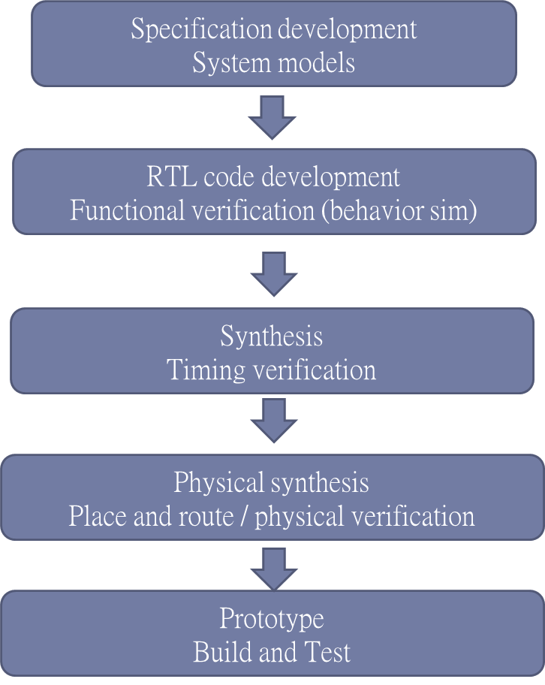
Cell based IC designed flow

Slide 5
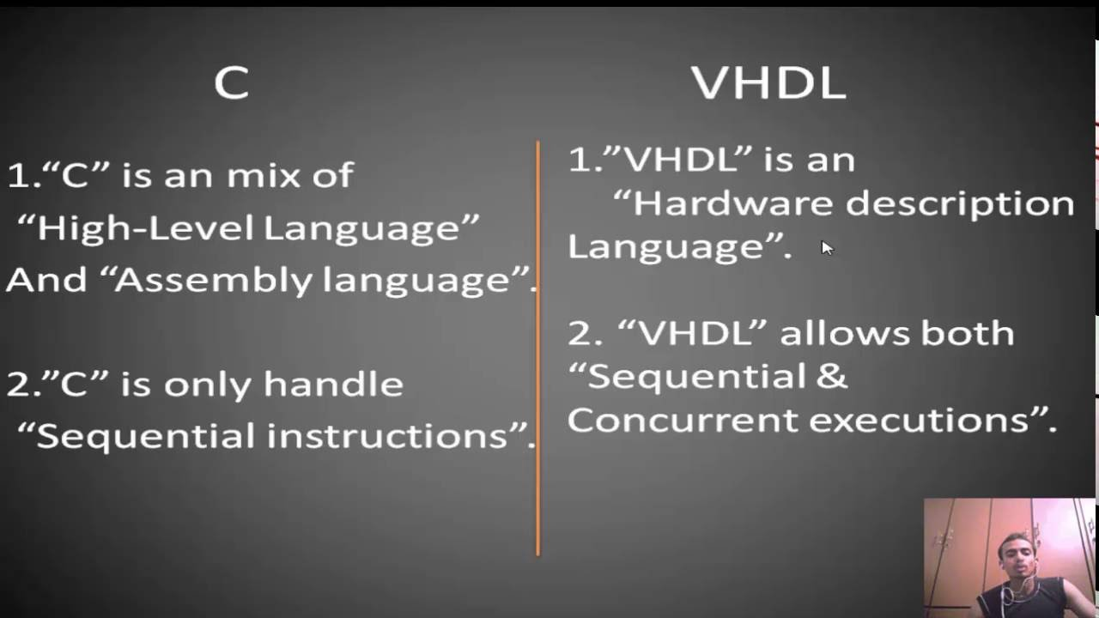
C Code vs Verilog

Slide 6
Basic Layout of Verilog
Modules communicate externally with input, output and inout ports
A module can be instantiated in another module
/* sample code FA_MIX.v */
module FA_MIX (A, B, CIN, SUM, COUT);
input A, B, CIN;
output SUM, COUT;
reg COUT;
reg T1, T2, T3;
wire S1;
xor X1 (S1, A, B); // Gate instantiation
always@ (A or B or CIN) // Always Block
begin
T1 = A & CIN;
T2 = B & CIN;
T3 = A & B;
COUT = (T1 | T2 | T3);
end
assign SUM = S1 ^ CIN; // Continuous assignment
endmodule
module module_name( input/output port);
//Port declaration
input xxx;
output xxx;
//Reg or wire declaration
reg xxx;
wire xxx;
//continuous assignment
assign xxx = OOOOOO;
always@(sensitive list w/ edge trigger) begin
Sequential logic
end
always@(sensitive list ) begin
Combinational logic
end
endmodule

Slide 7
Keywords
Note : All keywords are defined in lower case
Examples :
module, endmodule
input, output, inout
wire, reg
integer, real, time
posedge, negedge
not, and, nand, or, nor, xor
parameter
begin, end
if .. else, case … endcase (mostly used)
while, repeat, for loop (mostly used in test pattern)
$finish, $display, $monitor
Note: anything start with $ is a system syntax, not used in design.

Slide 8
Module Instantiation
Call by order
Call by name
module dff (clk, d, q);
input clk, d;
output q;
reg q;
always @(posedge clk) q = d;
endmodule
wire clk_i;
wire input, output;
dff f1(clk_i, input, output)
wire clk_i;
wire input, output;
dff f1(.clk(clk_i), .d(input), .q(output))

Slide 9
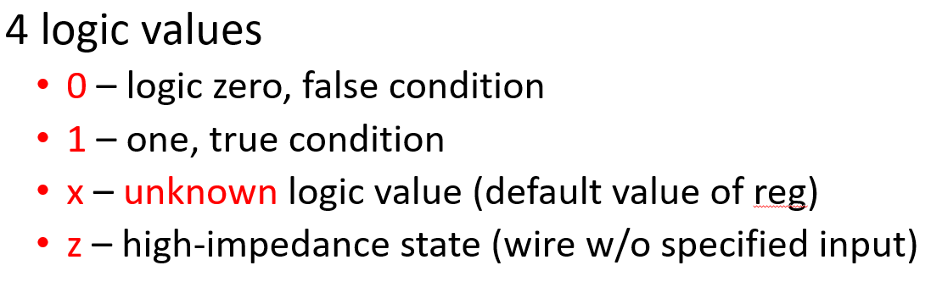
Integer Constant Numbers
Format :
<size>’<base><value>
’<base><value>
<value>
Example : 4’d16 , 4’b0001 When <size> is less than <value> , the upper bits are truncated.
If grater , it will extend.
2’b1101 => 2’b01
4’b01 or 4’b11 => 4’b 0001 or 4’b0011

Slide 10
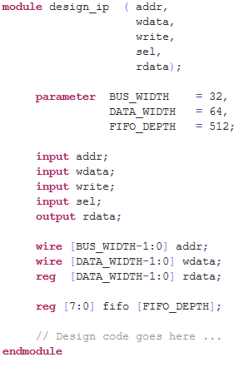
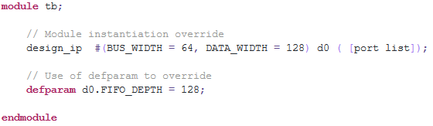
Parameters
Parameters are not variables, they are constants.
Can be modified at compilation time
parameter IDLE = 4’d0;
parameter RIGHT_SHIFT = 4’d1;
parameter LEFT_SHIFT = 4’d2;
always@(*)
If(cur_state==IDLE)
…

Slide 11
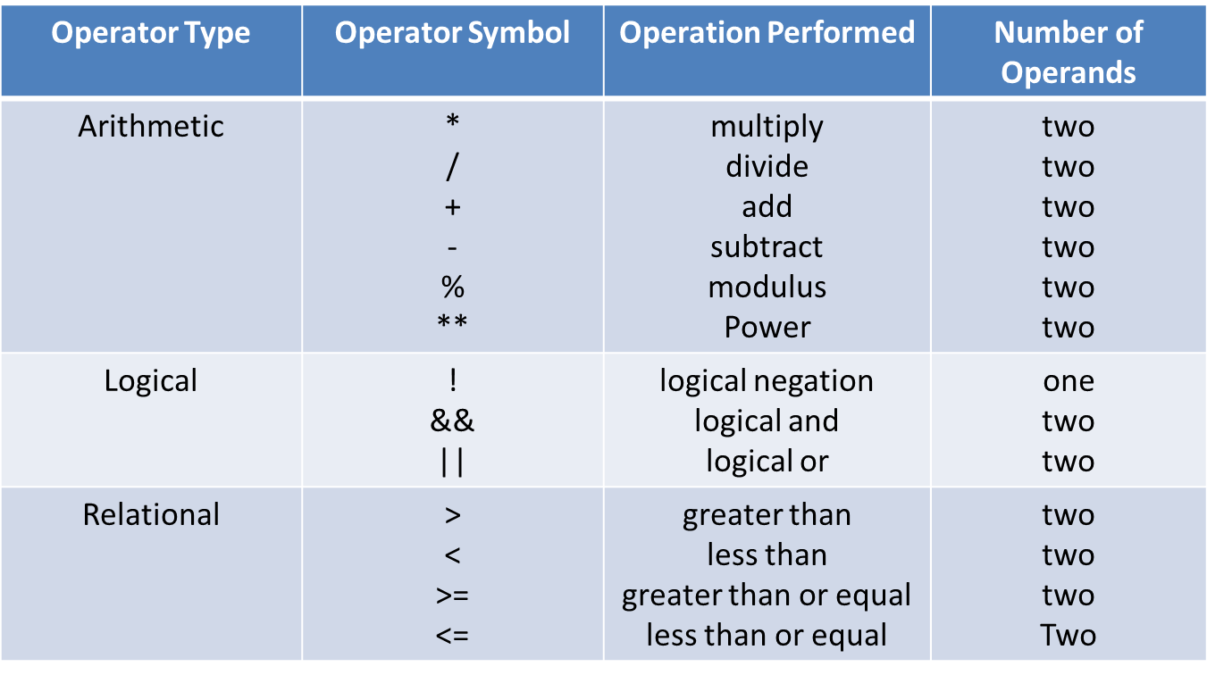
Operators[1/3]

Slide 12
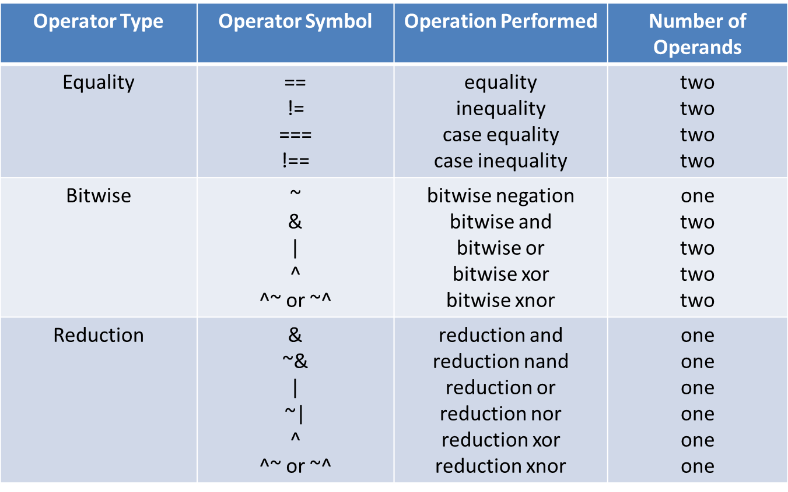
Operators[2/3]
Notes:
== 值相等 1 == 1 不能->x==x
=== 意義相等 x === x
~^ xor

Slide 13
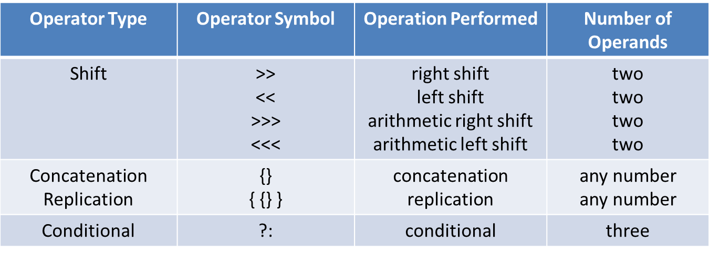
Operators[3/3]
Ex : A=(set==1)?B:C;
EX : A={B,C,D};
A is 16 bits, B is 8 bits, C is 6 bits, D is 2 bits
A = {B,C,D} or
A = {4’d0, B[7:3], C[5:1], D[1], 1’d0}

Slide 14
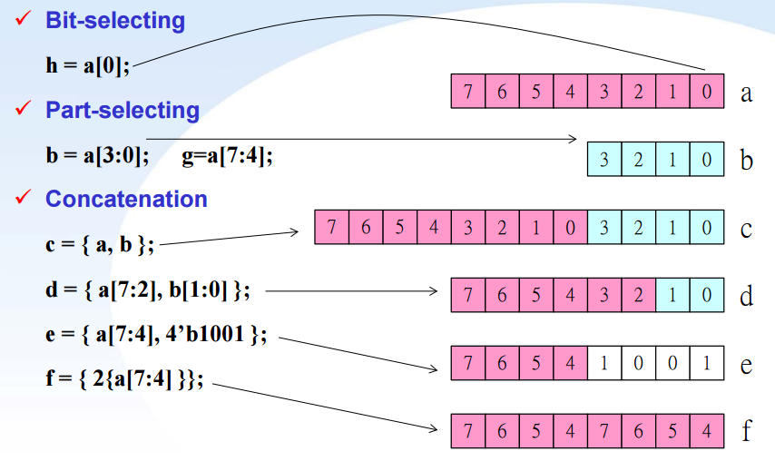
Bit extraction and Combination

Slide 15
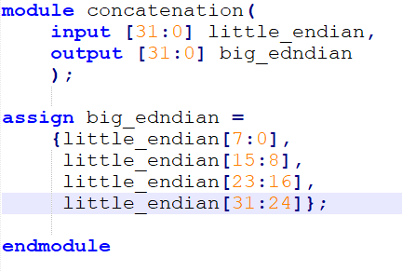

Partial bit operation
little endian
31:24
23:16
15:8
7:0
31:24 | 23:16 | 15:8 | 7:0
big endian

Slide 16
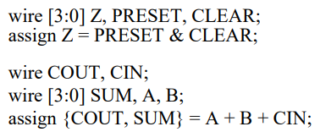
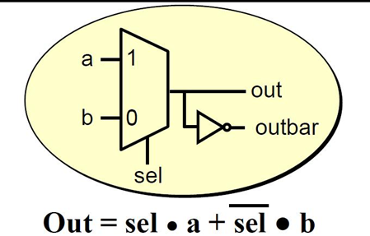
wire & assign
wire
Physical wires in a circuit
Cannot in left hand side of assignment in always block
Wire doesn’t store its value
Input, output, and inout default wire data type
assign
Models behavior of combinational logic
Assign a value to a net using continuous assignment
Left hand side of continuous assignment cannot be register type
assign out = ( sel )? A : B;
assign outbar = ~out;

Slide 17
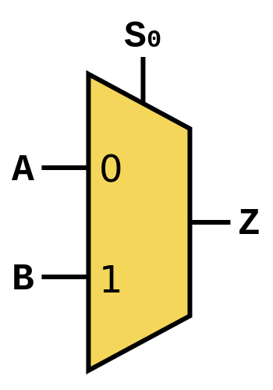
reg & always block
reg
Variable in verilog
Manipulated within behavior modeling(always block)
In always block, only can use reg on left hand side of assignment
“reg” data type isn’t exactly synthesized to a really register
reg z;
always @(sel or a or b) begin
if(sel)
z = b;
else
z = a;
end
wire z;
assign z = (sel)?b:a;
Sensitive list: put all signals which affect output,
can use * to let compiler help
Sensitive list must be specified completely,
otherwise behavior may mismatch with simulation

Slide 18

Register
Register(Flip-flop) is implied when use @(posedge clk) or @(negedge clk) in an always block
a
clk
reg out;
always @(posedge clk) begin
out <= a*b;
end
X
out
b
input Din, clk, rst;
output reg Dout;
always @( negedge rst or posedge clk ) begin
if ( !rst )
Dout <= 1’b0;
else
Dout <= Din;
end
Din
Dout
DFF
CLK
Reset

Slide 19
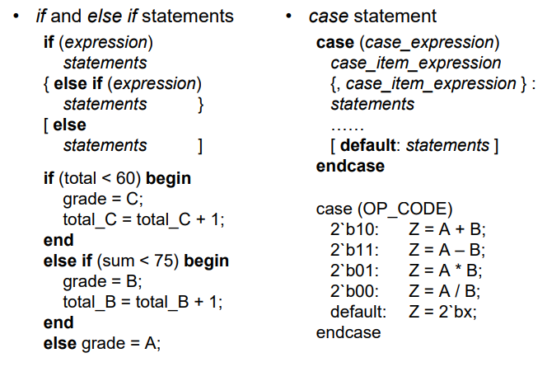
Conditional Statements

Slide 20
Avoid Inferred latch
Inferred latch generate by compiler
Variable assigned within always block that isn’t fully specified
case (expression)
alter_1, alter_2: stm_1;
alter_3: stm_2;
…
default: default_stm;
endcase
input [1:0] sl;
output reg [3:0]out;
always@(sl) begin
case (sl)
2’b00: out = 4’b0001;
2’b01: out = 4’b0010;
endcase
end
always @( a, b ) begin
if( a ) begin …; end
else if ( b ) begin ; end
else begin …; end
end
when b=1x, out=out => generate latch
Why inferred latch is bad
Notes:
Always block
Flip flop: Event-expression contain posedge or negedge
Combinational logic: not contain posedge or negedge
Latchs: variable assigned within always block that isn’t fully specified

Slide 21
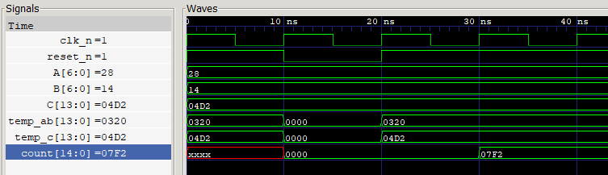
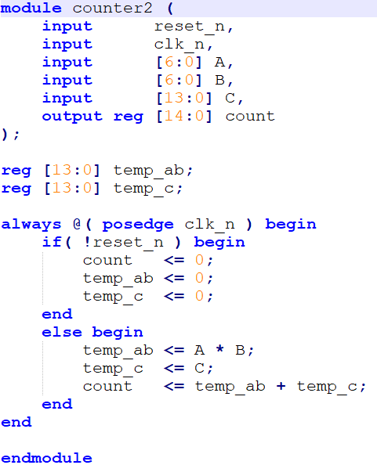
Blocking vs Non-Blocking
A
temp
X
B
output
+
temp_c
C

Slide 22
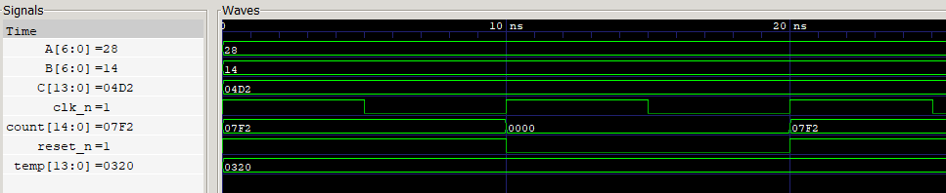
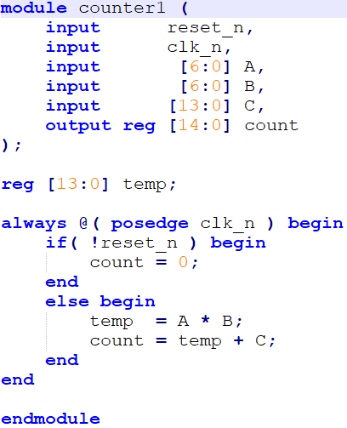
Blocking vs Non-Blocking
A
temp
X
B
output
+
C

Slide 23
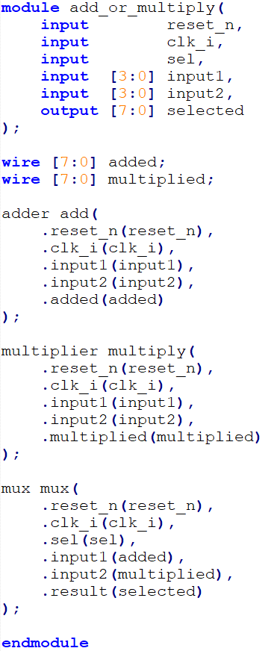
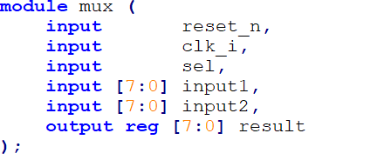
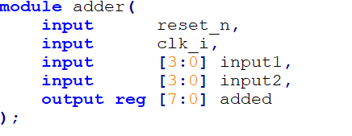
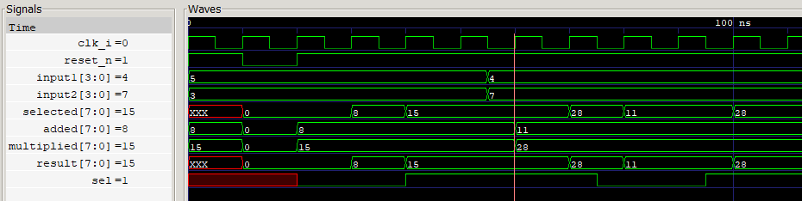
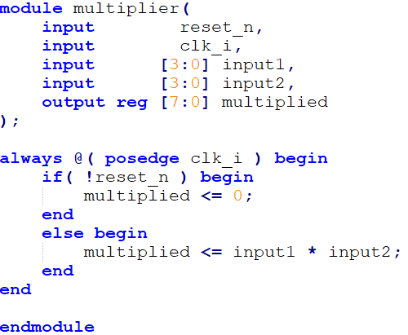
Nested module
multiplier
input1
multiplied
input2
sel
mux
clk_i
selected
Reset_n
adder
added

